Slide 1
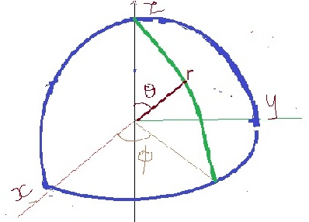
SPHERICAL LAPLACIAN
$∇^{2}$$ψ=\frac{∂^{2}ψ}{{∂x}^{2}}+\frac{∂^{2}ψ}{{∂y}^{2}}+\frac{∂^{2}ψ}{{∂z}^{2}}= \frac{∂^{2}ψ}{{∂r}^{2}}+ \frac{1}{r^{2}}\frac{∂^{2}ψ}{{∂θ}^{2}}++ \frac{1}{r^{2}\sin^{2}θ}\frac{∂^{2}ψ}{{∂ϕ}^{2}}$
Dr. S. ANBARASU Ph.D., Assistant Professor, Department of Physics, St. Joseph’s College, Tiruchirappalli-620002

Slide 2
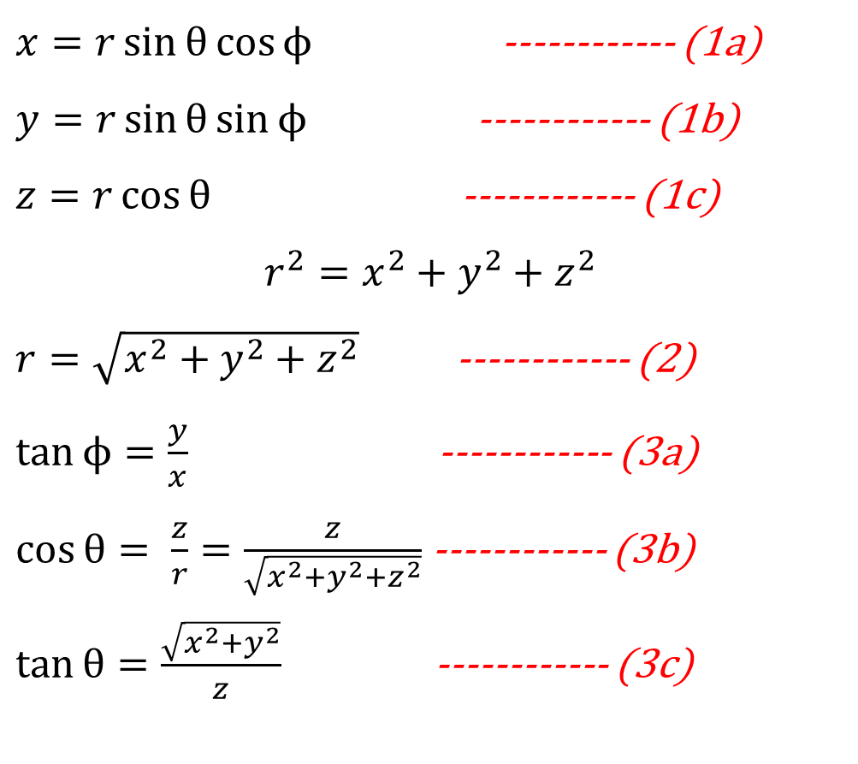
$x=r\sin{θ}cos{ϕ}$------------ (1a)
$y=r\sin{θ}\sin{ϕ}$ ------------ (1b)
$z=r\cos{θ}$------------ (1c)
$$r^{2}=x^{2}+y^{2}+z^{2}$$
$r=\sqrt{x^{2}+y^{2}+z^{2}}$------------ (2)
$\tan{ϕ}=\frac{y}{x}$------------ (3a)
$\cos{θ}= \frac{z}{r}=\frac{z}{\sqrt{x^{2}+y^{2}+z^{2}}}$------------ (3b)
$\tan{θ}=\frac{\sqrt{x^{2}+y^{2}}}{z}$------------ (3c)
Dr. S. ANBARASU Ph.D., Assistant Professor, Department of Physics, St. Joseph’s College, Tiruchirappalli-620002

Slide 3
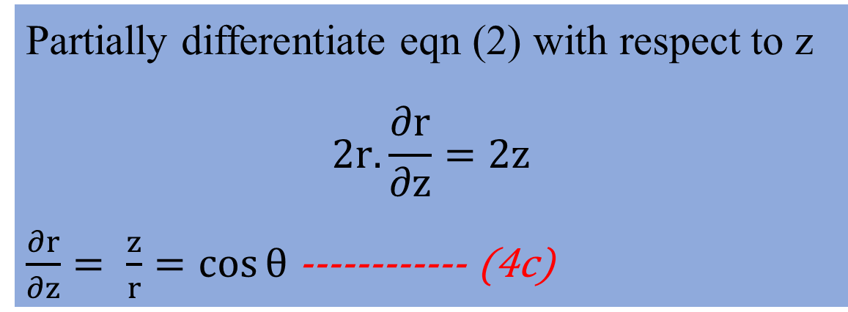
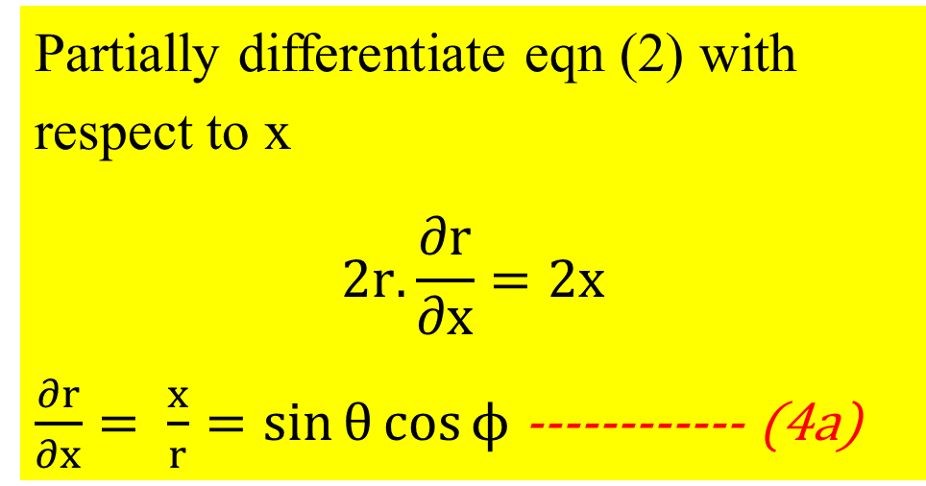

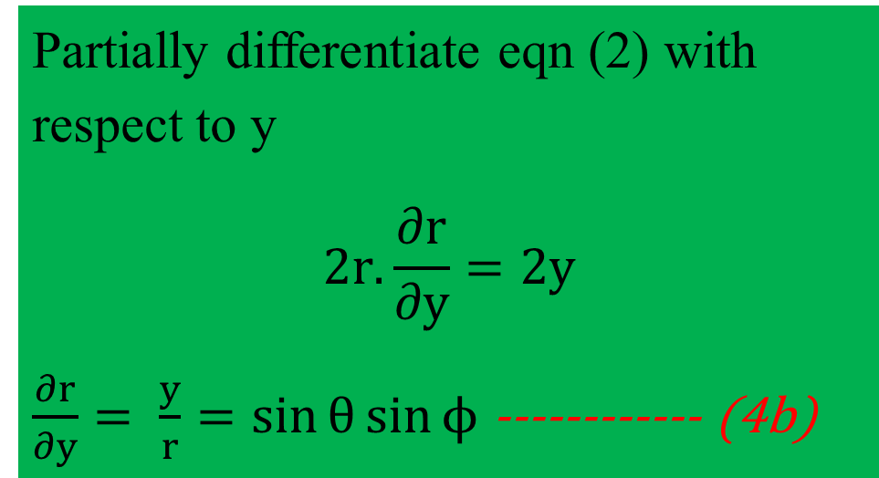
Take eqn (2)${ r}^{2}=x^{2}+y^{2}+z^{2}$
Partially differentiate eqn (2) with respect to x
$$2r.\frac{∂r}{∂x}=2x$$
$\frac{∂r}{∂x}= \frac{x}{r}=\sin{θ}cos{ϕ}$------------ (4a)
Partially differentiate eqn (2) with respect to y
$$2r.\frac{∂r}{∂y}=2y$$
$\frac{∂r}{∂y}= \frac{y}{r}=\sin{θ}\sin{ϕ}$------------ (4b)
Partially differentiate eqn (2) with respect to z
$$2r.\frac{∂r}{∂z}=2z$$
$\frac{∂r}{∂z}= \frac{z}{r}=\cos{θ}$------------ (4c)
Dr. S. ANBARASU Ph.D., Assistant Professor, Department of Physics, St. Joseph’s College, Tiruchirappalli-620002

Slide 4
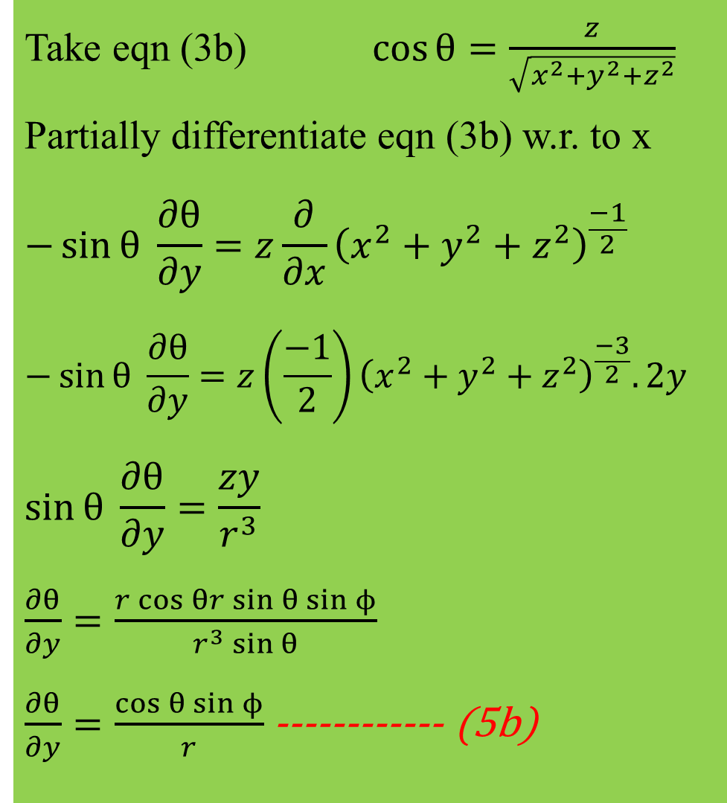
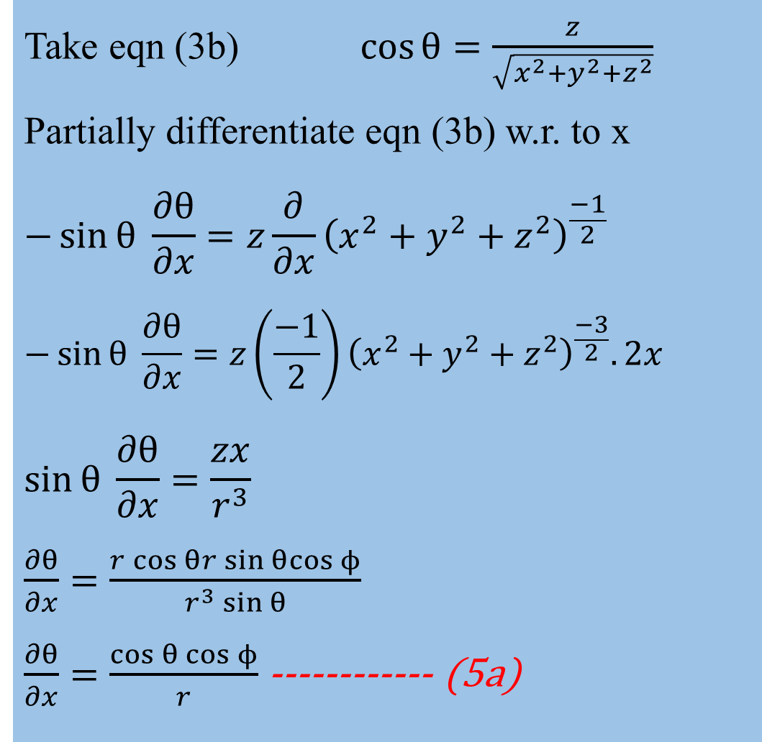
Take eqn (3b)$\cos{θ}=\frac{z}{\sqrt{x^{2}+y^{2}+z^{2}}}$
Partially differentiate eqn (3b) w.r. to x
$$−\sin{θ} \frac{∂θ}{∂x}=z\frac{∂}{∂x}{\left(x^{2}+y^{2}+z^{2}\right)}^{\frac{−1}{2}}$$
$$−\sin{θ} \frac{∂θ}{∂x}=z\left(\frac{−1}{2}\right){\left(x^{2}+y^{2}+z^{2}\right)}^{\frac{−3}{2}}.2x$$
$$\sin{θ} \frac{∂θ}{∂x}=\frac{zx}{r^{3}}$$
$$\frac{∂θ}{∂x}=\frac{r\cos{θ}r\sin{θ}cos{ϕ}}{r^{3}\sin{θ}}$$
$\frac{∂θ}{∂x}=\frac{\cos{θ}\cos{ϕ}}{r}$------------ (5a)
Take eqn (3b)$\cos{θ}=\frac{z}{\sqrt{x^{2}+y^{2}+z^{2}}}$
Partially differentiate eqn (3b) w.r. to x
$$−\sin{θ} \frac{∂θ}{∂y}=z\frac{∂}{∂x}{\left(x^{2}+y^{2}+z^{2}\right)}^{\frac{−1}{2}}$$
$$−\sin{θ} \frac{∂θ}{∂y}=z\left(\frac{−1}{2}\right){\left(x^{2}+y^{2}+z^{2}\right)}^{\frac{−3}{2}}.2y$$
$$\sin{θ} \frac{∂θ}{∂y}=\frac{zy}{r^{3}}$$
$$\frac{∂θ}{∂y}=\frac{r\cos{θr\sin{θ}\sin{ϕ}}}{r^{3}\sin{θ}}$$
$\frac{∂θ}{∂y}=\frac{\cos{θ}\sin{ϕ}}{r}$------------ (5b)
Dr. S. ANBARASU Ph.D., Assistant Professor, Department of Physics, St. Joseph’s College, Tiruchirappalli-620002

Slide 5
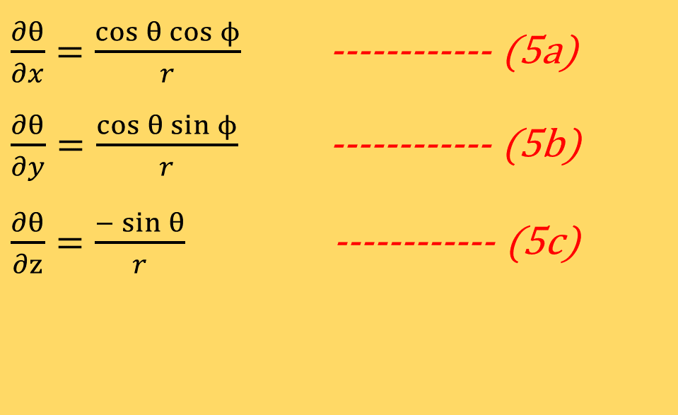
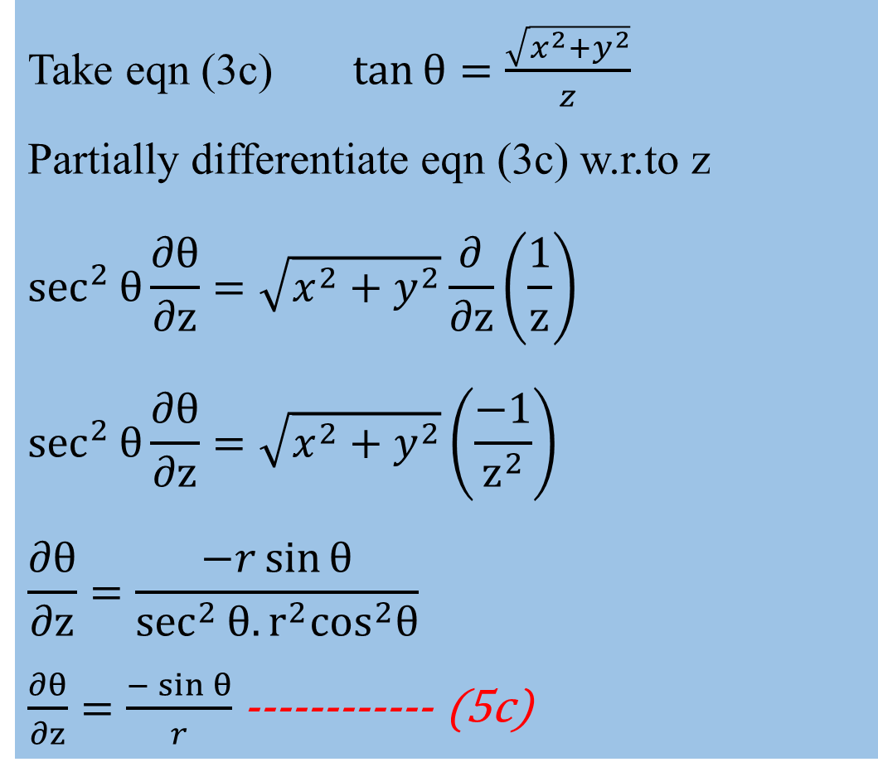
Take eqn (3c)$\tan{θ}=\frac{\sqrt{x^{2}+y^{2}}}{z}$
Partially differentiate eqn (3c) w.r.to z
$$\sec^{2}θ{\frac{∂θ}{∂z}}=\sqrt{x^{2}+y^{2}}\frac{∂}{∂z}\left(\frac{1}{z}\right)$$
$$\sec^{2}θ{\frac{∂θ}{∂z}}=\sqrt{x^{2}+y^{2}}\left(\frac{−1}{z^{2}}\right)$$
$$\frac{∂θ}{∂z}=\frac{−r\sin{θ}}{\sec^{2}θ.{r^{2}\cos^{2}θ}}$$
$\frac{∂θ}{∂z}=\frac{−\sin{θ}}{r}$------------ (5c)
$\frac{∂θ}{∂x}=\frac{\cos{θ}\cos{ϕ}}{r}$------------ (5a)
$\frac{∂θ}{∂y}=\frac{\cos{θ}\sin{ϕ}}{r}$------------ (5b)
$\frac{∂θ}{∂z}=\frac{−\sin{θ}}{r}$------------ (5c)
Dr. S. ANBARASU Ph.D., Assistant Professor, Department of Physics, St. Joseph’s College, Tiruchirappalli-620002

Slide 6
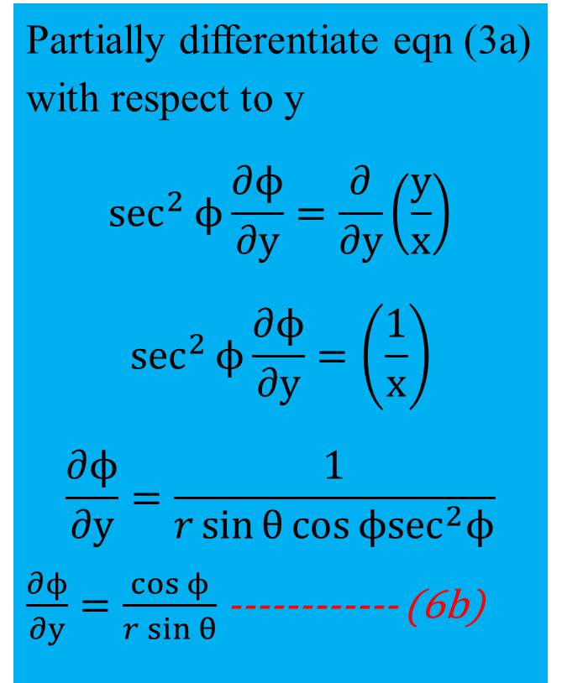
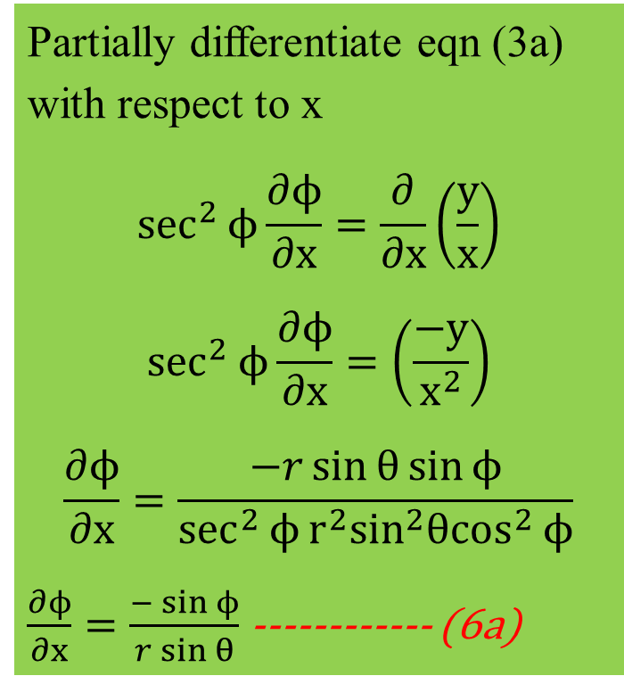

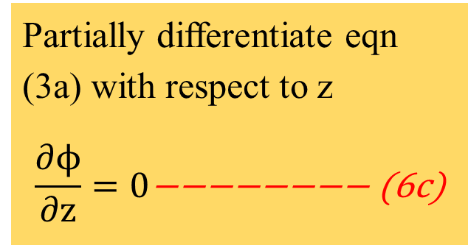
Take eqn (3a) $\tan{ϕ}=\frac{y}{x}$
Partially differentiate eqn (3a) with respect to x
$$\sec^{2}ϕ{\frac{∂ϕ}{∂x}}=\frac{∂}{∂x}\left(\frac{y}{x}\right)$$
$$\sec^{2}ϕ{\frac{∂ϕ}{∂x}}=\left(\frac{−y}{x^{2}}\right)$$
$$\frac{∂ϕ}{∂x}=\frac{−r\sin{θ}\sin{ϕ}}{\sec^{2}ϕ{r^{2}\sin^{2}θ\cos^{2}}ϕ}$$
$\frac{∂ϕ}{∂x}=\frac{−\sin{ϕ}}{r\sin{θ}}$------------ (6a)
Partially differentiate eqn (3a) with respect to y
$$\sec^{2}ϕ{\frac{∂ϕ}{∂y}}=\frac{∂}{∂y}\left(\frac{y}{x}\right)$$
$$\sec^{2}ϕ{\frac{∂ϕ}{∂y}}=\left(\frac{1}{x}\right)$$
$$\frac{∂ϕ}{∂y}=\frac{1}{r\sin{θ}cos{ϕ\sec^{2}ϕ}}$$
$\frac{∂ϕ}{∂y}=\frac{\cos{ϕ}}{r\sin{θ}}$------------ (6b)
Partially differentiate eqn (3a) with respect to z
$$\frac{∂ϕ}{∂z}=0\text{−−−−−−−− (}\text{6}\text{c}\text{)}$$
Dr. S. ANBARASU Ph.D., Assistant Professor, Department of Physics, St. Joseph’s College, Tiruchirappalli-620002

Slide 7
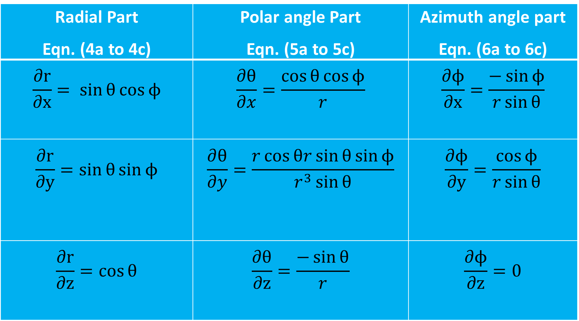
Radial Part Eqn. (4a to 4c) | Polar angle Part Eqn. (5a to 5c) | Azimuth angle part Eqn. (6a to 6c)
$$\frac{∂r}{∂x}= \sin{θ}cos{ϕ}$$ | $$\frac{∂θ}{∂x}=\frac{\cos{θ}\cos{ϕ}}{r}$$ | $$\frac{∂ϕ}{∂x}=\frac{−\sin{ϕ}}{r\sin{θ}}$$
$$\frac{∂r}{∂y}=\sin{θ}\sin{ϕ}$$ | $$\frac{∂θ}{∂y}=\frac{r\cos{θr\sin{θ}\sin{ϕ}}}{r^{3}\sin{θ}}$$ | $$\frac{∂ϕ}{∂y}=\frac{\cos{ϕ}}{r\sin{θ}}$$
$$\frac{∂r}{∂z}=\cos{θ}$$ | $$\frac{∂θ}{∂z}=\frac{−\sin{θ}}{r}$$ | $$\frac{∂ϕ}{∂z}=0$$
Dr. S. ANBARASU Ph.D., Assistant Professor, Department of Physics, St. Joseph’s College, Tiruchirappalli-620002

Slide 8
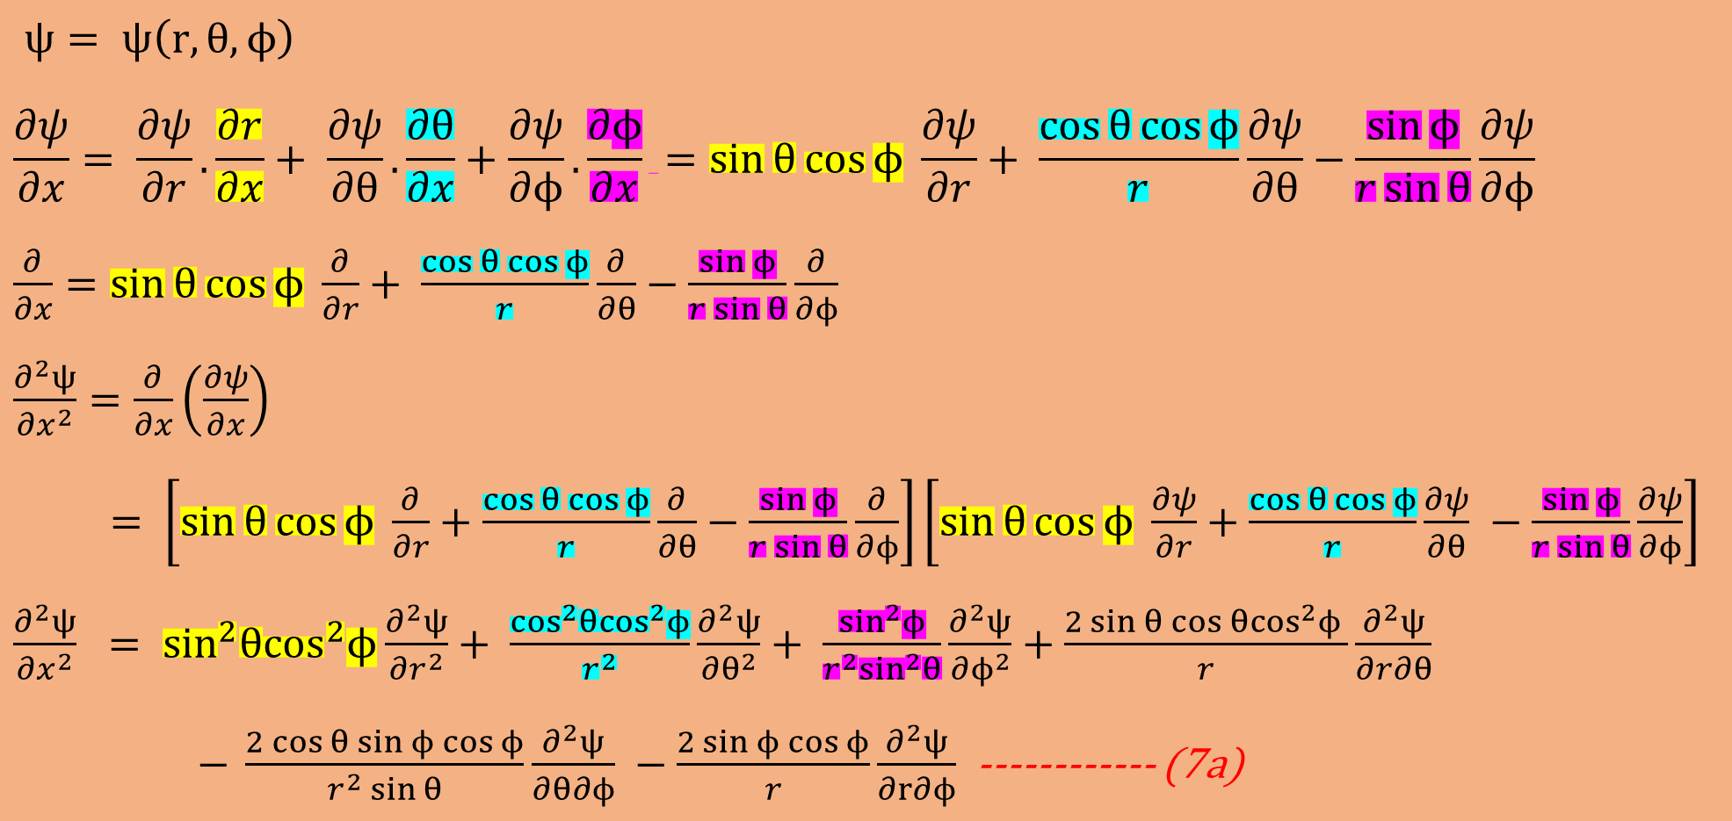
$ψ= ψ\left(r,θ,ϕ\right)$
$$\frac{∂ψ}{∂x}= \frac{∂ψ}{∂r}.\frac{∂r}{∂x}+ \frac{∂ψ}{∂θ}.\frac{∂θ}{∂x}+\frac{∂ψ}{∂ϕ}.\frac{∂ϕ}{∂x} =\sin{θ}cos{ϕ} \frac{∂ψ}{∂r}+ \frac{\cos{θ}\cos{ϕ}}{r}\frac{∂ψ}{∂θ}−\frac{\sin{ϕ}}{r\sin{θ}}\frac{∂ψ}{∂ϕ}$$
$$\frac{∂}{∂x}=\sin{θ}cos{ϕ} \frac{∂}{∂r}+ \frac{\cos{θ}\cos{ϕ}}{r}\frac{∂}{∂θ}−\frac{\sin{ϕ}}{r\sin{θ}}\frac{∂}{∂ϕ}$$
$$\frac{∂^{2}ψ}{{∂x}^{2}}=\frac{∂}{∂x}\left(\frac{∂ψ}{∂x}\right)$$
$$= \left[\sin{θ}cos{ϕ} \frac{∂}{∂r}+\frac{\cos{θ}\cos{ϕ}}{r}\frac{∂}{∂θ}−\frac{\sin{ϕ}}{r\sin{θ}}\frac{∂}{∂ϕ}\right]\left[\sin{θ}cos{ϕ} \frac{∂ψ}{∂r}+\frac{\cos{θ}\cos{ϕ}}{r}\frac{∂ψ}{∂θ} −\frac{\sin{ϕ}}{r\sin{θ}}\frac{∂ψ}{∂ϕ}\right]$$
$$\frac{∂^{2}ψ}{{∂x}^{2}} = \sin^{2}θ\cos^{2}ϕ\frac{∂^{2}ψ}{{∂r}^{2}}+ \frac{\cos^{2}θ\cos^{2}ϕ}{r^{2}}\frac{∂^{2}ψ}{{∂θ}^{2}}+ \frac{\sin^{2}ϕ}{r^{2}\sin^{2}θ}\frac{∂^{2}ψ}{{∂ϕ}^{2}}+\frac{{2\sin{θ\cos{θ}}cos}^{2}ϕ }{r}\frac{∂^{2}ψ}{∂r∂θ}$$
$− \frac{2\cos{θ\sin{ϕ\cos{ϕ}}}}{r^{2}\sin{θ}}\frac{∂^{2}ψ}{∂θ∂ϕ} −\frac{2{\sin{ϕ\cos{ϕ}}}}{r}\frac{∂^{2}ψ}{∂r∂ϕ}$------------ (7a)
Dr. S. ANBARASU Ph.D., Assistant Professor, Department of Physics, St. Joseph’s College, Tiruchirappalli-620002

Slide 9
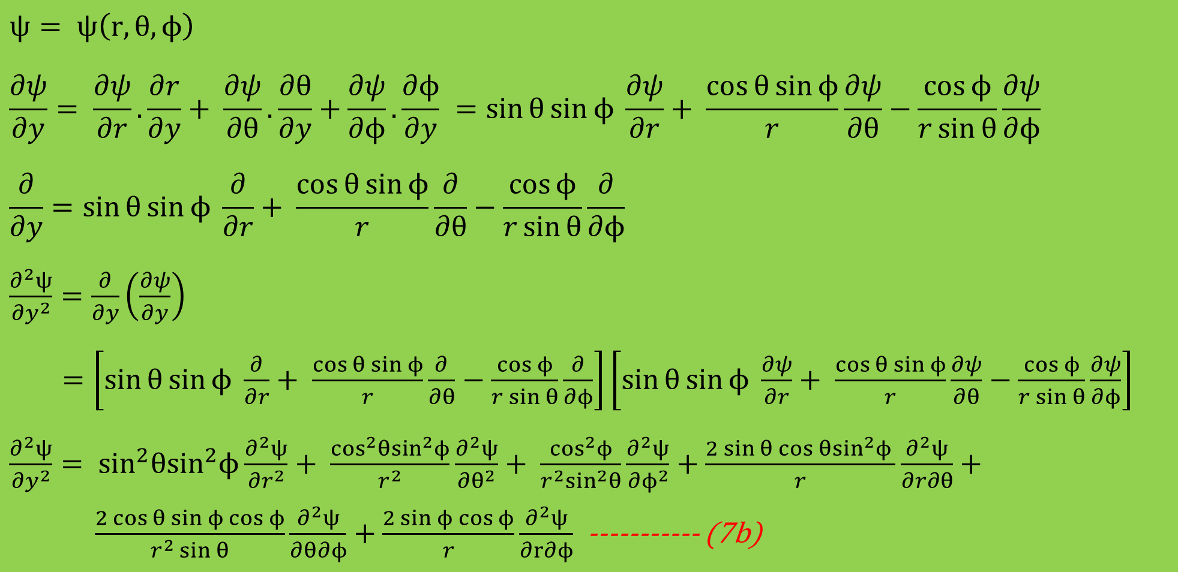
$$ψ= ψ\left(r,θ,ϕ\right)$$
$$\frac{∂ψ}{∂y}= \frac{∂ψ}{∂r}.\frac{∂r}{∂y}+ \frac{∂ψ}{∂θ}.\frac{∂θ}{∂y}+\frac{∂ψ}{∂ϕ}.\frac{∂ϕ}{∂y} =\sin{θ}sin{ϕ} \frac{∂ψ}{∂r}+ \frac{\cos{θ}\sin{ϕ}}{r}\frac{∂ψ}{∂θ}−\frac{\cos{ϕ}}{r\sin{θ}}\frac{∂ψ}{∂ϕ}$$
$$\frac{∂}{∂y}=\sin{θ}sin{ϕ} \frac{∂}{∂r}+ \frac{\cos{θ}\sin{ϕ}}{r}\frac{∂}{∂θ}−\frac{\cos{ϕ}}{r\sin{θ}}\frac{∂}{∂ϕ}$$
$$\frac{∂^{2}ψ}{{∂y}^{2}}=\frac{∂}{∂y}\left(\frac{∂ψ}{∂y}\right)$$
$$=\left[\sin{θ}sin{ϕ} \frac{∂}{∂r}+ \frac{\cos{θ}\sin{ϕ}}{r}\frac{∂}{∂θ}−\frac{\cos{ϕ}}{r\sin{θ}}\frac{∂}{∂ϕ}\right]\left[\sin{θ}sin{ϕ} \frac{∂ψ}{∂r}+ \frac{\cos{θ}\sin{ϕ}}{r}\frac{∂ψ}{∂θ}−\frac{\cos{ϕ}}{r\sin{θ}}\frac{∂ψ}{∂ϕ}\right]$$
$\frac{∂^{2}ψ}{{∂y}^{2}}= \sin^{2}θ\sin^{2}ϕ\frac{∂^{2}ψ}{{∂r}^{2}}+ \frac{\cos^{2}θ\sin^{2}ϕ}{r^{2}}\frac{∂^{2}ψ}{{∂θ}^{2}}+ \frac{\cos^{2}ϕ}{r^{2}\sin^{2}θ}\frac{∂^{2}ψ}{{∂ϕ}^{2}}+\frac{{2\sin{θ\cos{θ}}sin}^{2}ϕ }{r}\frac{∂^{2}ψ}{∂r∂θ}+ \frac{2\cos{θ\sin{ϕ\cos{ϕ}}}}{r^{2}\sin{θ}}\frac{∂^{2}ψ}{∂θ∂ϕ}+\frac{2{\sin{ϕ\cos{ϕ}}}}{r}\frac{∂^{2}ψ}{∂r∂ϕ}$----------- (7b)
Dr. S. ANBARASU Ph.D., Assistant Professor, Department of Physics, St. Joseph’s College, Tiruchirappalli-620002

Slide 10
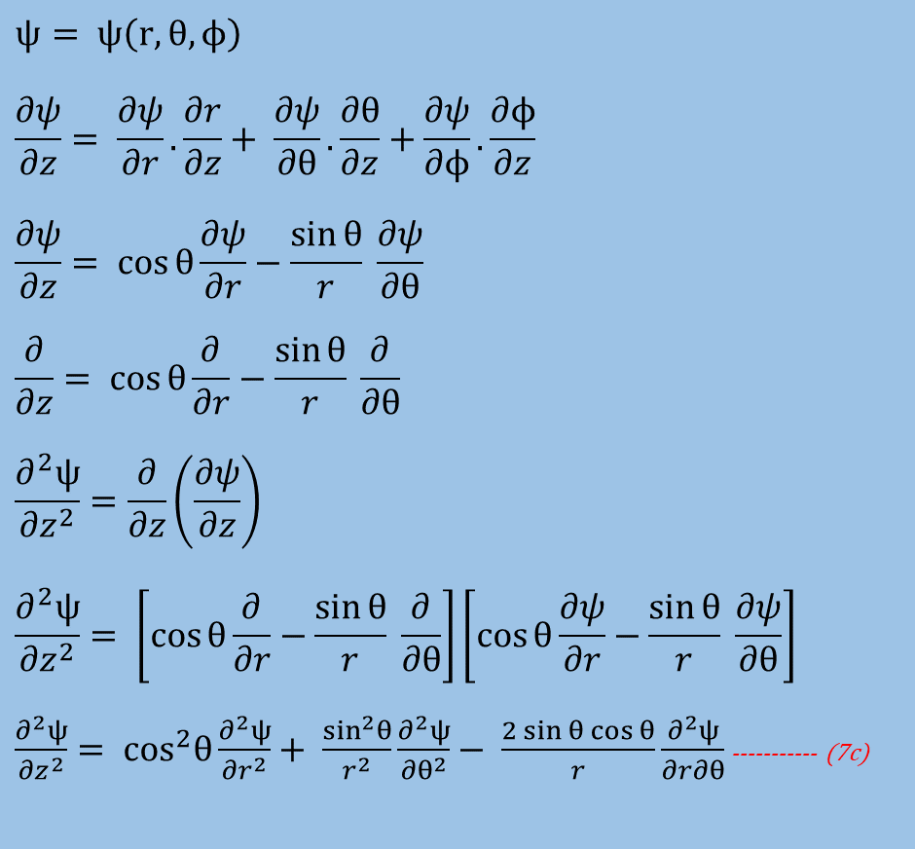
$$ψ= ψ\left(r,θ,ϕ\right)$$
$$\frac{∂ψ}{∂z}= \frac{∂ψ}{∂r}.\frac{∂r}{∂z}+ \frac{∂ψ}{∂θ}.\frac{∂θ}{∂z}+\frac{∂ψ}{∂ϕ}.\frac{∂ϕ}{∂z}$$
$$\frac{∂ψ}{∂z}= \cos{θ}\frac{∂ψ}{∂r}−\frac{\sin{θ}}{r} \frac{∂ψ}{∂θ}$$
$$\frac{∂}{∂z}= \cos{θ}\frac{∂}{∂r}−\frac{\sin{θ}}{r} \frac{∂}{∂θ}$$
$$\frac{∂^{2}ψ}{{∂z}^{2}}=\frac{∂}{∂z}\left(\frac{∂ψ}{∂z}\right)$$
$$\frac{∂^{2}ψ}{{∂z}^{2}}= \left[\cos{θ}\frac{∂}{∂r}−\frac{\sin{θ}}{r} \frac{∂}{∂θ}\right]\left[\cos{θ}\frac{∂ψ}{∂r}−\frac{\sin{θ}}{r} \frac{∂ψ}{∂θ}\right]$$
$\frac{∂^{2}ψ}{{∂z}^{2}}= \cos^{2}θ\frac{∂^{2}ψ}{{∂r}^{2}}+ \frac{\sin^{2}θ}{r^{2}}\frac{∂^{2}ψ}{{∂θ}^{2}}− \frac{2\sin{θ\cos{θ}}}{r}\frac{∂^{2}ψ}{∂r∂θ}$----------- (7c)
Dr. S. ANBARASU Ph.D., Assistant Professor, Department of Physics, St. Joseph’s College, Tiruchirappalli-620002

Slide 11

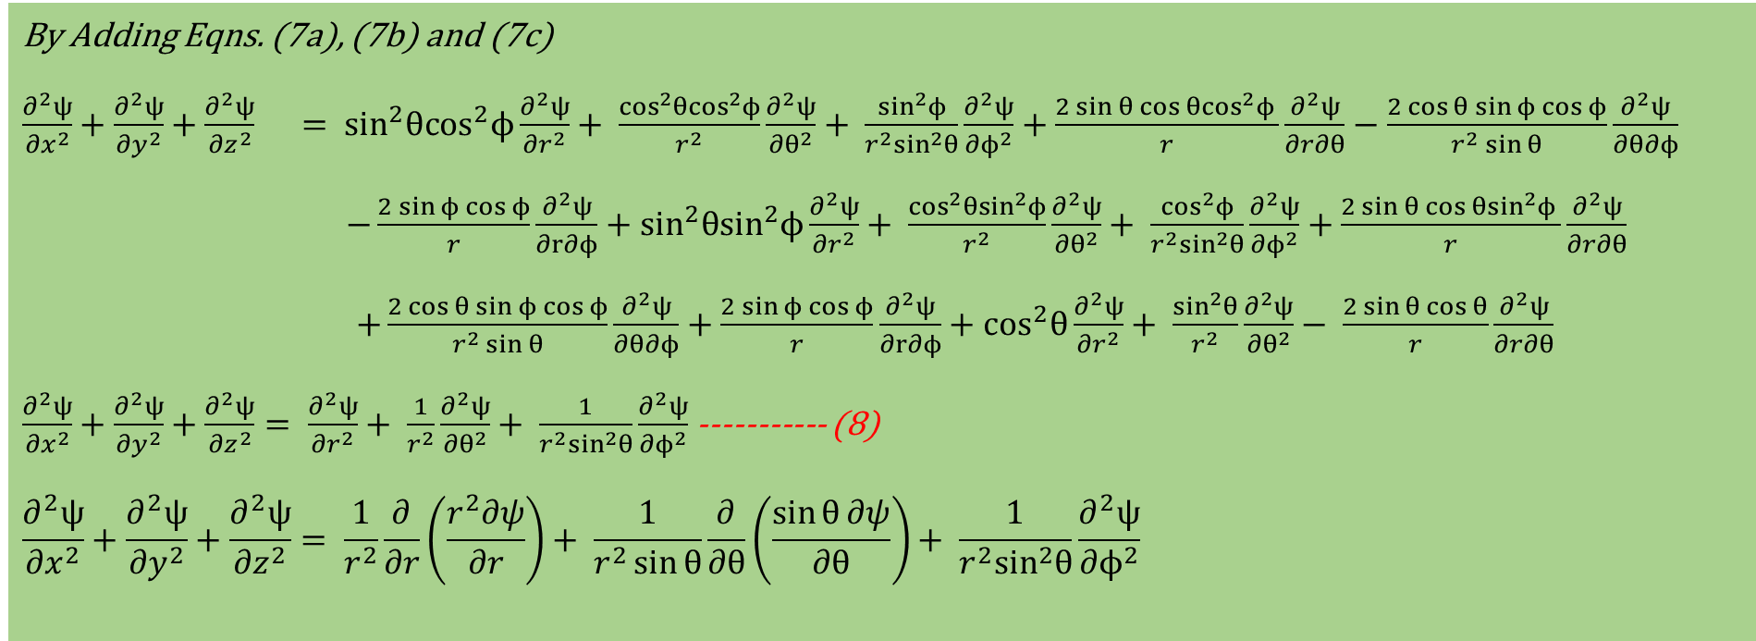
By Adding Eqns. (7a), (7b) and (7c)
$$\frac{∂^{2}ψ}{{∂x}^{2}}+\frac{∂^{2}ψ}{{∂y}^{2}}+\frac{∂^{2}ψ}{{∂z}^{2}} = \sin^{2}θ\cos^{2}ϕ\frac{∂^{2}ψ}{{∂r}^{2}}+ \frac{\cos^{2}θ\cos^{2}ϕ}{r^{2}}\frac{∂^{2}ψ}{{∂θ}^{2}}+ \frac{\sin^{2}ϕ}{r^{2}\sin^{2}θ}\frac{∂^{2}ψ}{{∂ϕ}^{2}}+\frac{{2\sin{θ\cos{θ}}cos}^{2}ϕ }{r}\frac{∂^{2}ψ}{∂r∂θ}−\frac{2\cos{θ\sin{ϕ\cos{ϕ}}}}{r^{2}\sin{θ}}\frac{∂^{2}ψ}{∂θ∂ϕ}$$
$$−\frac{2{\sin{ϕ\cos{ϕ}}}}{r}\frac{∂^{2}ψ}{∂r∂ϕ}+\sin^{2}θ\sin^{2}ϕ\frac{∂^{2}ψ}{{∂r}^{2}}+ \frac{\cos^{2}θ\sin^{2}ϕ}{r^{2}}\frac{∂^{2}ψ}{{∂θ}^{2}}+ \frac{\cos^{2}ϕ}{r^{2}\sin^{2}θ}\frac{∂^{2}ψ}{{∂ϕ}^{2}}+\frac{{2\sin{θ\cos{θ}}sin}^{2}ϕ }{r}\frac{∂^{2}ψ}{∂r∂θ}$$
$$+\frac{2\cos{θ\sin{ϕ\cos{ϕ}}}}{r^{2}\sin{θ}}\frac{∂^{2}ψ}{∂θ∂ϕ}+\frac{2{\sin{ϕ\cos{ϕ}}}}{r}\frac{∂^{2}ψ}{∂r∂ϕ}+\cos^{2}θ\frac{∂^{2}ψ}{{∂r}^{2}}+ \frac{\sin^{2}θ}{r^{2}}\frac{∂^{2}ψ}{{∂θ}^{2}}− \frac{2\sin{θ\cos{θ}}}{r}\frac{∂^{2}ψ}{∂r∂θ}$$
$\frac{∂^{2}ψ}{{∂x}^{2}}+\frac{∂^{2}ψ}{{∂y}^{2}}+\frac{∂^{2}ψ}{{∂z}^{2}}= \frac{∂^{2}ψ}{{∂r}^{2}}+ \frac{1}{r^{2}}\frac{∂^{2}ψ}{{∂θ}^{2}}+ \frac{1}{r^{2}\sin^{2}θ}\frac{∂^{2}ψ}{{∂ϕ}^{2}}$----------- (8)
$$\frac{∂^{2}ψ}{{∂x}^{2}}+\frac{∂^{2}ψ}{{∂y}^{2}}+\frac{∂^{2}ψ}{{∂z}^{2}}= \frac{1}{r^{2}}\frac{∂}{∂r}\left(\frac{r^{2}∂ψ}{∂r}\right)+ \frac{1}{r^{2}\sin{θ}}\frac{∂}{∂θ}\left(\frac{\sin{θ}∂ψ}{∂θ}\right)+ \frac{1}{r^{2}\sin^{2}θ}\frac{∂^{2}ψ}{{∂ϕ}^{2}}$$
$\frac{1}{r^{2}\sin{θ}}\frac{∂}{∂θ}\left(\frac{\sin{θ}∂ψ}{∂θ}\right)$ is the net outflow of flux per unit volume
$\frac{1}{r^{2}\sin^{2}θ}\frac{∂^{2}ψ}{{∂ϕ}^{2}}$ is the net azimuthal outflow of flux per unit volume
$\frac{1}{r^{2}}\frac{∂}{∂r}\left(\frac{r^{2}∂ψ}{∂r}\right)$ is the net radial outflow of flux per unit volume
THANK YOU
Dr. S. ANBARASU Ph.D., Assistant Professor, Department of Physics, St. Joseph’s College, Tiruchirappalli-620002

